Slide 1
COVID Data Analysis
AJ Fairweather

Slide 2
Introduction
AJ Fairweather
Our World in Data has produced a Coronvirus data set, our aim is to analyse this set using specific asignments.
This was done by:
Data preparation
Numerical operations
In-built functions
These actions were performed to find insights in specific instances regarding the coronavirus and in a global context and conditions for each country.

Slide 3
Summary of Accomplishments
AJ Fairweather
Situation: Given the Our World in Data dataset of the coronavirus, complete a series of assignments.
Objective: Gain insights into various aspects of the data set.
Action: Utilizing the pandas, data-frame properties, data preparation, conditionals, functions, and mathematical operators on the data to gather information required in the assignments.
Results: Assignment was completed with 81.25% of tasks implemented correctly.
Aftermaths: Additional development of skills involving data-frame preparation. If this task was to be redone, additional time would be spent researching f-strings and the best way of formatting functions.

Slide 4
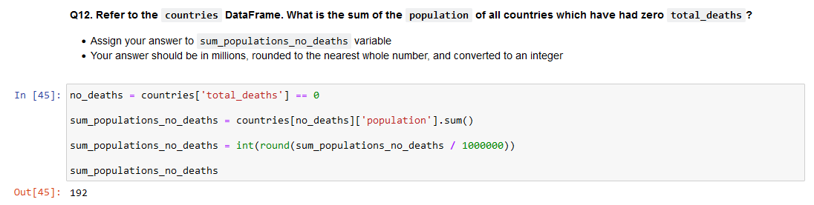
Coronavirus Analysis
AJ Fairweather
An example of an assignment: Finding the sum of the population of all countries that had no deaths as a result of the virus, then to have this presented to the nearest million.
In this task, the use of in built functions, dataframe preparation and mathematical operators was required to gain the correct value.

Slide 5
Coronavirus Analysis
AJ Fairweather
A series of asignments requried a new dataframe to be created, and then by use of mathematical operators and in built functions discover properties of the data set.
These assignments was able to develop a method of finding the average total deaths per million where hospital beds per thousand and higher and lower than the mean hospital beds per thousand.

Slide 6
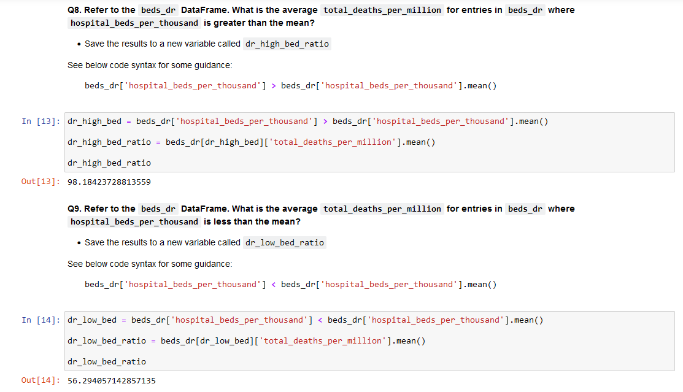
Coronavirus Analysis - Evidence
AJ Fairweather

Slide 7
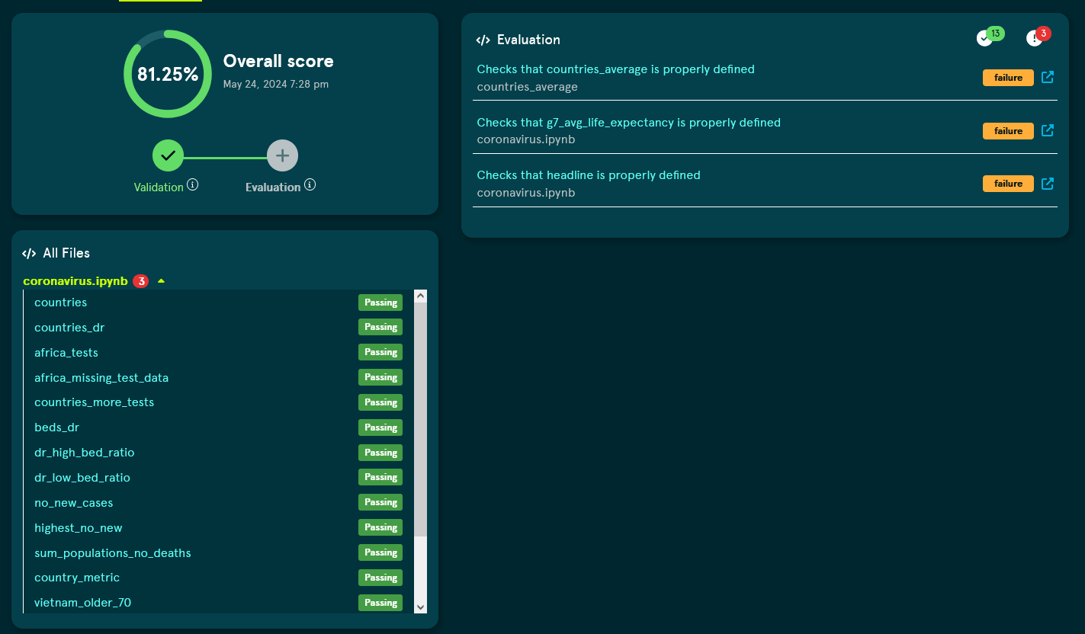
Coronavirus Analysis - Evidence
AJ Fairweather

